Slide 1
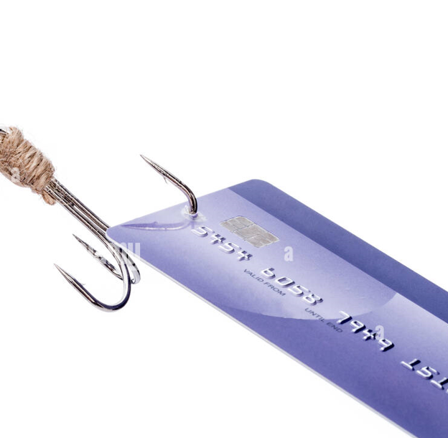
Predicting Credit Card Fraud

Slide 2

Quantify the problem with credit card fraud.
By 2023, estimates indicate retailers will lose $130 billion each year on fraudulent sales
Only 54% of these businesses are "somewhat confident" they would be able to detect fraudulent activity on time
The amount of credit card data available on the dark web increased by 135% last year
As many as 9 Million Americans have their credit card information stolen each year.

Slide 3
Prevention
Don’t use unsecure websites.
Beware of phishing scams.
Be on the lookout for skimmers.
Don’t post sensitive information on social media.
Get comfortable with mobile payment apps.
Shop in stores that have chip readers.
Don’t save your credit card information online.
Use a virtual credit card number online.
Use a password manager.
Get a chip card with PIN capacity.
Don’t trust public Wi-Fi for financial transactions.
Set up a fraud alert or credit freeze if your card is lost or stolen.
Review your credit reports regularly.

Slide 4
Visualizations to depict some of these quantifications
Based on the dataset, Department Stores were more likely to be impacted by fraud
Consumer preference is to shop online – 75% of fraudulent transactions happened online
Mastercard accounted for 53% of fraudulent activities while Visa card had 36%

Slide 5
Visualization to show locations of these issues
From 1990-2000 there was little fraud happening in the US most of it was in Mexico, Algeria and Fiji.
From 2001-2010 there was more fraud in the US and all over the country. But the bulk of it happened in Algeria, Turkey, and Haiti.
From 2011-2019 you can see most of the fraud in the US happened on the eastern side of the country. But the bulk of it was in Rome.

Slide 6
Bank Early Detection
24 Million transaction records were reviewed
Tensorflow and T-SNE analysis were used to validate and plan the data
The data model showed a valid result of over 99%

Slide 7
Sources
Facts on Fraud: https://wallethub.com/edu/cc/credit-debit-card-fraud-statistics/25725
Simulated Data: https://www.kaggle.com/datasets/ealtman2019/credit-card-transactions
Preventing Fraud: https://diamondvalleyfcu.org/blog/5-ways-avoid-credit-card-fraud
Reporting Fraud: https://www.rocklandtrust.com/learning-center/popular-links/reporting-fraud

Slide 8

Questions

